Slide 1
NYC Green Taxi Case Study
Analysis and Modelling

Slide 2
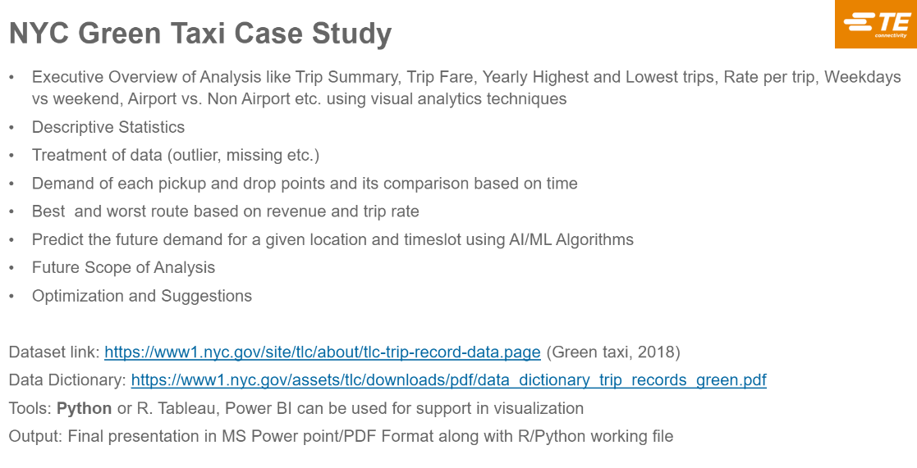

Slide 3
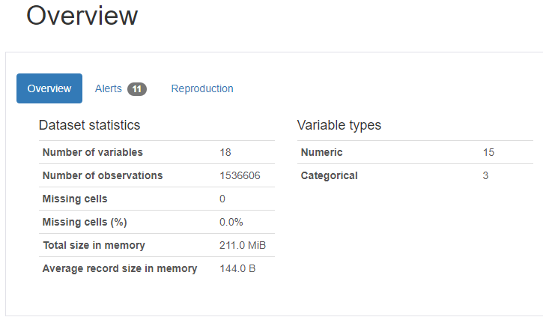
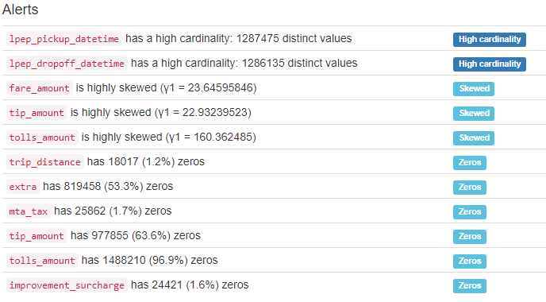
Exploratory Data Analysis
Including Statistical Analysis at attribute level

Slide 4
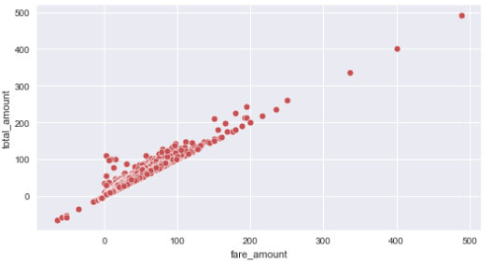
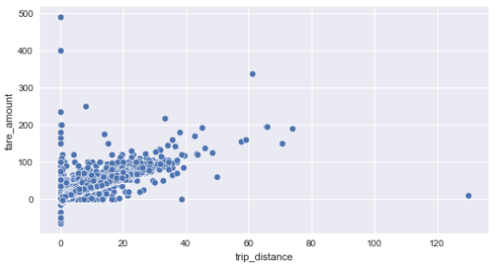
Trip Fare Amount
Based on the correlation graph it is observed that Fare amount is strongly correlated to Trip Distance and Total amount
Plotted Scatter Plot between Fare amount, Trip Distance and Total Amount
Based on Scatter Plot it is evident that Fare Amount is increasing linearly with Total Amount and Trip Distance

Slide 5
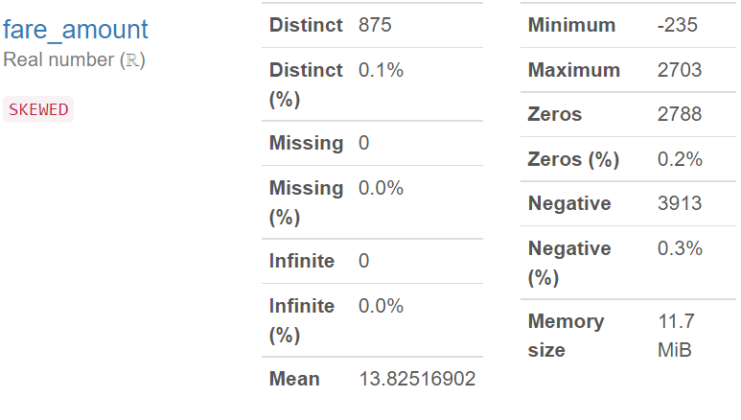
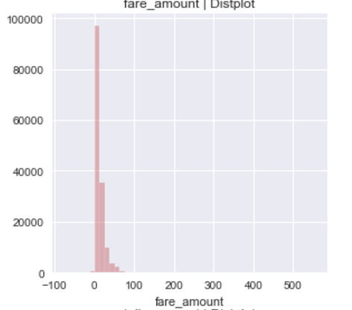
Trip Fare Amount
Based on the histogram plot it is evident that the fare amount is right skewed and skewness value is 23.64
The average fare amount is $13.825 whereas the maximum and minimum fare are 2703 and -235 respectively

Slide 6
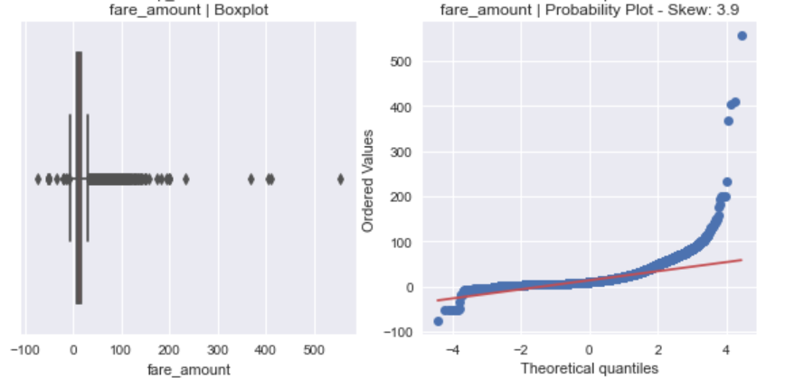
Trip Fare Amount
Based on the histogram plot it is evident that the fare amount is right skewed
110570 outliers are there in Fare amount Attribute as per the calculation based on IQR Approcah

Slide 7
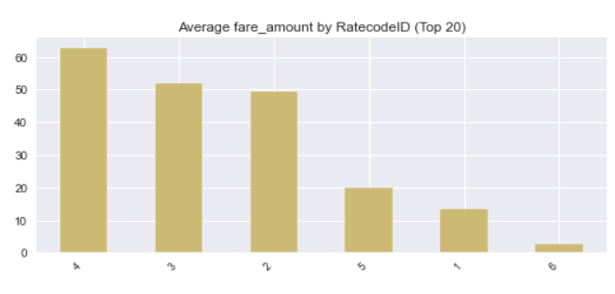
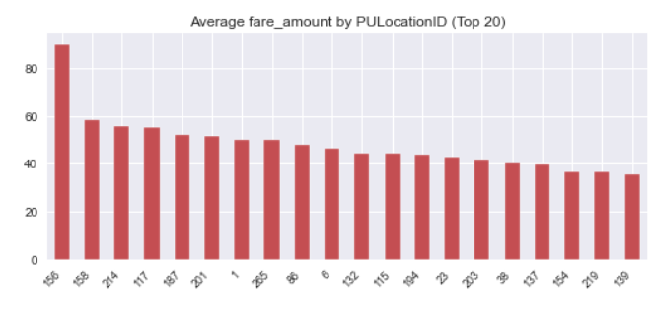
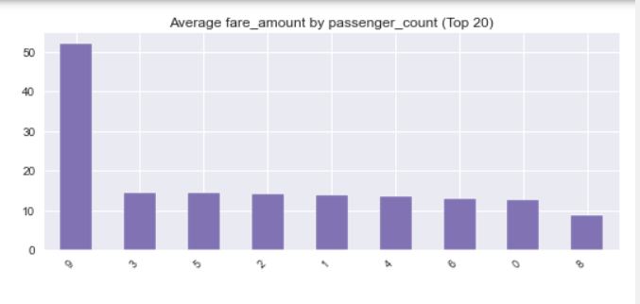
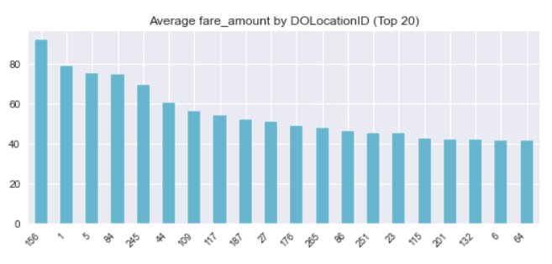
Average Fare Amount (Avg. Fare per Trip)
Based on the Bar plot Average fare amount is highest for156 PULocationID(taxi zone-engaged) and DOLacationID(taxi zone-disengaged).
Average Fare Amount is highest for vehicle having 9 passengers count(outlier only)
Average Fare Amount is highest for RatecodeID 4 i.e. for Nassau or Westchester trips and lowest for 6 i.e.,for Group Ride

Slide 8
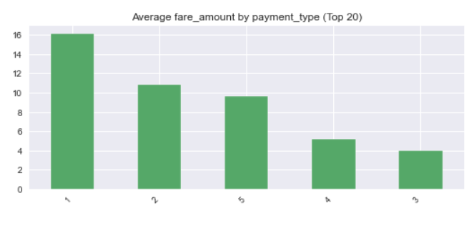
Trip Fare Amount (Avg. Fare per Trip)
Based on the bar plot plotted against fare amount and payment type, it is observed that fare amount is highest for payment_type 1 i.e, for credit card whereas lowest for 3 (No Charge-may be some promotional offers)
Inference and Suggestion:
Hence the passenger should not use credit card as it’s most frequent payment option.

Slide 9
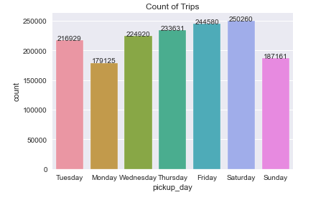
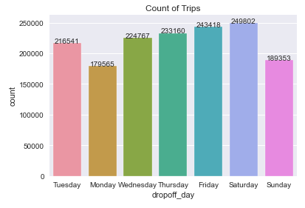
Count of Trips weekend vs. Weekday
Based on the bar plot plotted against Count of Trips, Pick Up day and Drop Off day, it is observed that on Saturday count of trips are maximum(both pick up and drop off) whereas on Monday number of Trips are minimum
Inference:
On Weekend people use to travel a lot to enjoy the weekends or goes on a vacation etc.

Slide 10
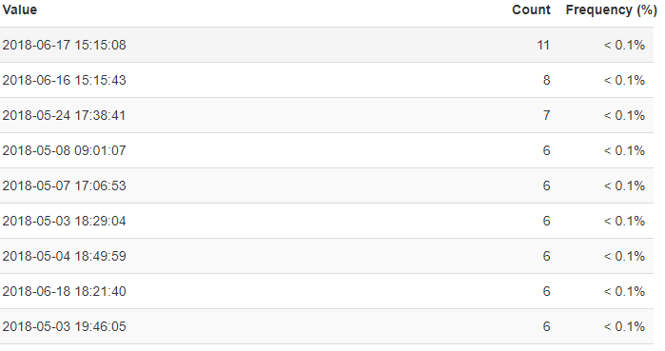
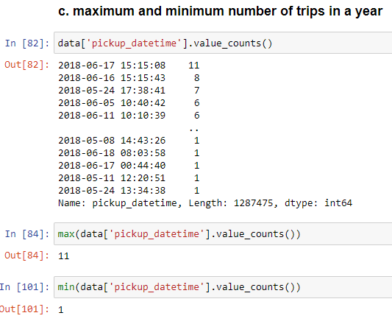
Maximum and minimum number of trips in a year
Based on the calculation, it’s observed that 11 is the maximum number of trips in a day whereas 1 is the minimum number of trips observed in the year

Slide 11
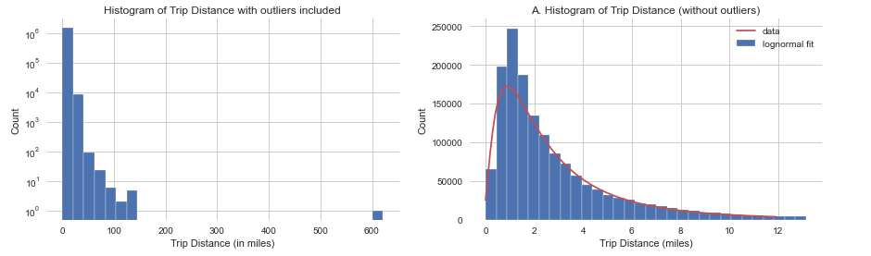
Trip Summary Distribution of trip distance Analysis

Slide 12
Distribution of trip distance Analysis
The Trip Distance is asymmetrically distributed, and it is skewed to the right, has a median smaller than its mean and both smaller than the standard deviation. The skewness is because variable has a lower boundary of 0 as The distance can't be negative. This distribution has a structure of a lognormal distribution. To the left is plotted the distribution of the entire raw set of Trip distance. To the right, outliers have been removed before plotting. Outliers are defined as any point located further than 3 standard deviations from the mean(as per IQR approach)
The hypothesis: The trips are not random. If there were random, we would have a Gaussian distribution(bell curve).

Slide 13
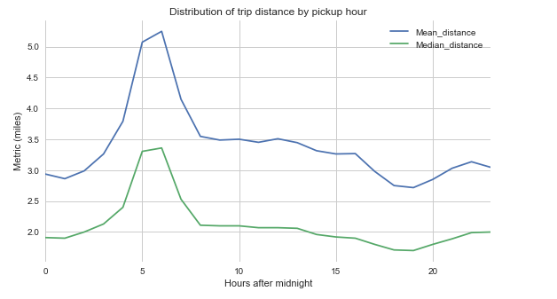
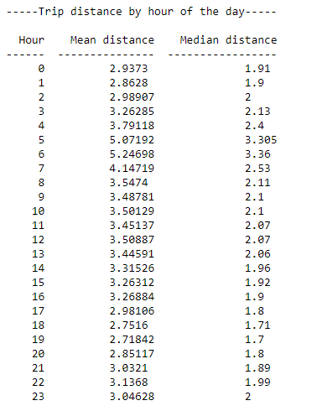
Trip Summary Impact of time of day on the trip distance

Slide 14
Impact of time of day on the trip distance
Observed long range trips in the morning and evenings. may be people commuting to work? If so how do they get back home. The evening peak are shorter than the morning peak. Hypothesizing that people are okay to take cabs in the morning to avoid being late to their early appointments while they would take public transportation in the evening.

Slide 15
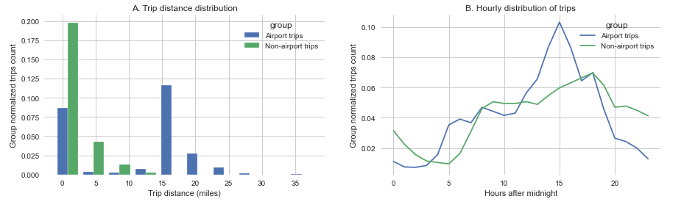
Airport vs. Non airport Trip Distance and Hourly distribution

Slide 16
Impact of time of day on the trip distance
A. The trip distance distribution shows two peaks. Airport trips follow the same trend as the rest of the trips for short trips (trip distance ≤ 2miles). However, there is also an increased number of long-range trips (18 miles) which might correspond to a great number people coming to airports from further residential areas. A check on google map shows that the distance between JFK and Manhattan is about 18 miles whereas Newark to Manhattan is 15 miles.
B. The hourly distribution shows that the number of trips at airports peaks around 3PM while it peaks 2 hours later. On the other hand, there is a shortage in airports riders at 2AM while the rest of NYC goes completely down 3 hours later 5AM

Slide 17
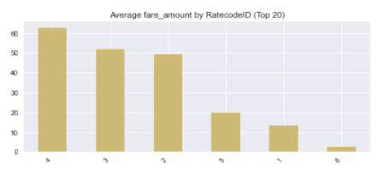
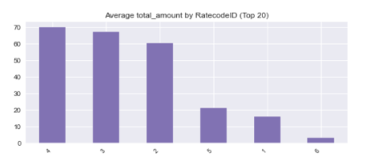
Best and worst Route
Based on the bar plot plotted against average fare amount , average total amount and RatecodeID, it is observed that RatecodeID 4 i.e, Nassau or Westchester have the highest average fare hence for passengers it will be wrost route as they need to pay more money (most expensive route).
Whereas RatecodeID 6 i.e, Group ride has the lowest average fare hence for passengers it will be mode of transport, as it will be least expensive. Additionally, non airport routes are least expensive and follows standard rate which is lowest route rate.
The hypothesis: Passengers assumes expensiveness as the measure of best and worst route

Slide 18
Future scope of analysis
We could tweak more to get better performance. Maybe we will try without smoothing or can produce some new features. Or we can try stacking different models.
Few interesting features that we could try are "is holiday or special day", "weather type", "season", "day or night", etc.

Slide 19
Optimization and suggestion
Note that I have not used the classical time series forecasting models like Holt-Winters or ARIMA. Because on their own they will not perform as well as the current models. However, we can certainly get benefits from them if we do stacking ensembling.
Since the data is very huge (containing more than 1.5 million records for just 2 months of data) hence Dask Architecture can be used which trains the model batch and will consume less time.

